Slide 1
Dr Emmanuel Ahene
Beyond basics –L3
Assembly Language Programming

Slide 2
Assembly Basic Syntax/structure
An assembly program can be divided into three sections:
The data section
The bss section
The text section

Slide 3
Memory Segments
A segmented memory model divides the system memory into groups of independent segments, referenced by pointers located in the segment registers. Each segment is used to contain a specific type of data. One segment is used to contain instruction codes, another segment stores the data elements, and a third segment keeps the program stack.

Slide 4
Memory Segments
In the light of the above discussion, we can specify various memory segments as:
Data segment - it is represented by .data section and the .bss. The .data section is used to declare the memory region where data elements are stored for the program.
This section cannot be expanded after the data elements are declared, and it remains static throughout the program.

Slide 5
Memory Segments
The .bss section is also a static memory section that contains buffers for data to be declared later in the program. This buffer memory is zero-filled.
Code segment - it is represented by .text section. This defines an area in memory that stores the instruction codes. This is also a fixed area. • Stack - this segment contains data values passed to functions and procedures within the program

Slide 6
ASSEMBLY REGISTERS
Processor operations mostly involve processing data. This data can be stored in memory and accessed from thereon.
However, reading data from and storing data into memory slows down the processor, as it involves complicated processes of sending the data request across the control bus, and into the memory storage unit and getting the data through the same channel.

Slide 7
ASSEMBLY REGISTERS
To speed up the processor operations, the processor includes some internal memory storage locations, called registers.
The registers stores data elements for processing without having to access the memory. A limited number of registers are built into the processor chip.

Slide 8
PROCESSOR REGISTERS
In IA-32 architecture, registers hold 32 bits. This means each
register can hold the values:
Unsigned : 0 to 4294967295
Signed: -2147483648 to 2147483647
In the x86_64 architecture, registers hold 64 bits. This means each
register can hold the values :
Usigned: 0 to 18,446,744,073,709,551,616
Signed: -9,223,372,036,854,775,808 to 9,223,372,036,854,775,807

Slide 9
Registers
Registers (32/64Bits) are grouped into three categories:
General registers
Control registers
Segment register

Slide 10
PROCESSOR REGISTERS (32 & 64 bits)
The general registers are further divided into the following groups:
Data registers
Pointer registers
Index registers

Slide 11
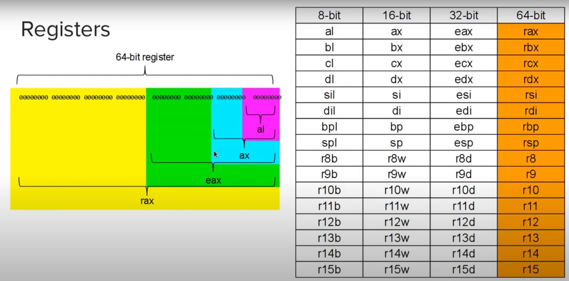
Register Table

Slide 12
Data Registers (32 bits)
Four 32-bit data registers are used for arithmetic, logical and other operations. These 32-bit registers can be used in three ways:
As complete 32-bit data registers: EAX, EBX,
ECX, EDX.
Lower halves of the 32-bit registers can be used
as four 16-bit data registers: AX, BX, CX and DX.
Lower and higher halves of the above-mentioned
four 16-bit registers can be used as eight 8-bit
data registers: AH, AL, BH, BL, CH, CL, DH, and
DL

Slide 13
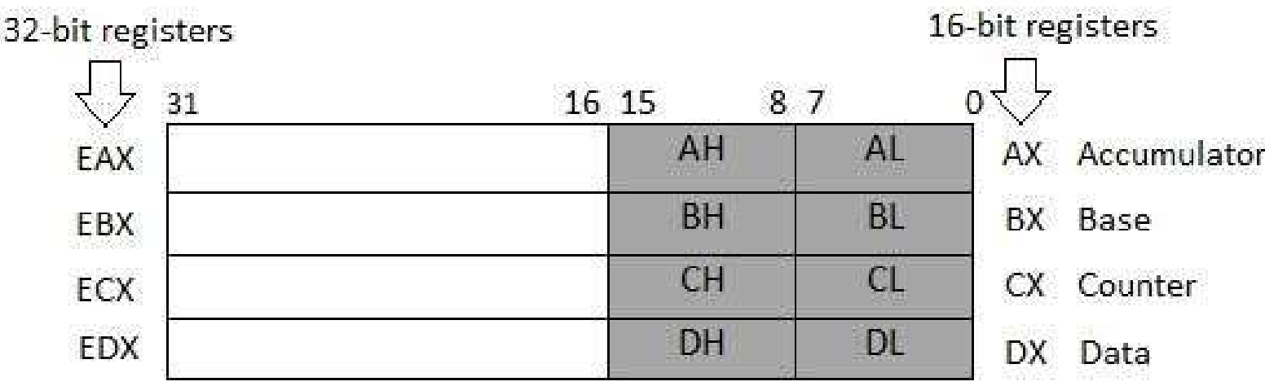
Data Registers (32 bits)

Slide 14
Data Registers
Some of these data registers has specific used in arithmetical operations.
AX is the primary accumulator; it is used in input/output and most arithmetic instructions.
For example, in multiplication operation, one operand is stored in EAX, or AX or AL register according to the size of the operand.
BX is known as the base register as it could be used in indexed addressing.

Slide 15
Data Registers
CX is known as the count register as the ECX, CX registers store the loop count in iterative operations. DX is known as the data register. It is also used in input/output operations.
It is also used with AX register along with DX for multiply and divide operations involving large values

Slide 16
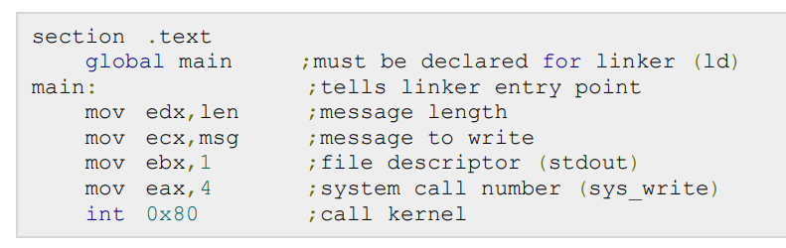
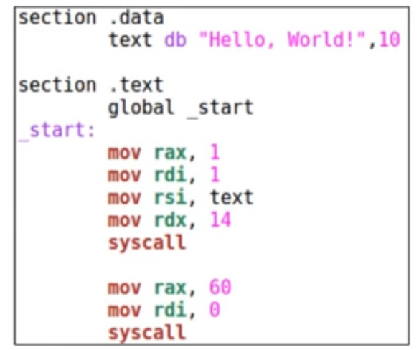
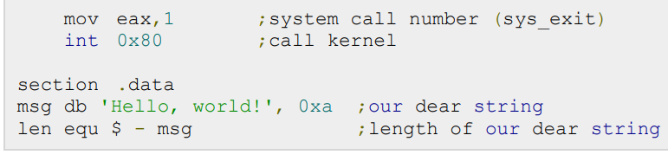
Hello World Source codes
Any differences?

Slide 17
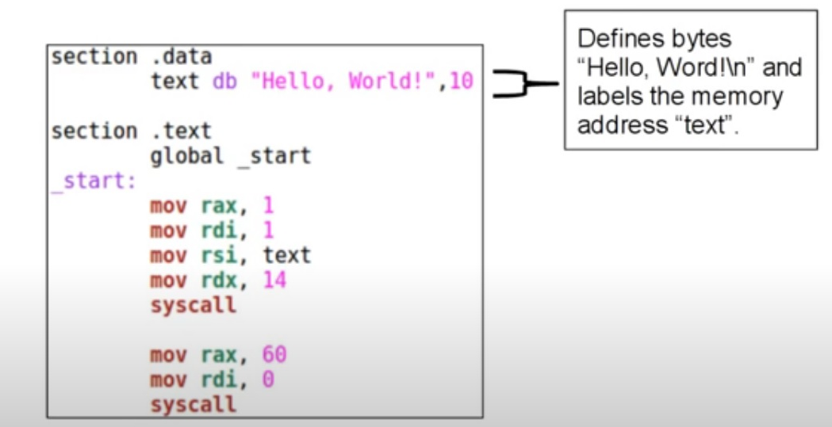
Hello World into details

Slide 18
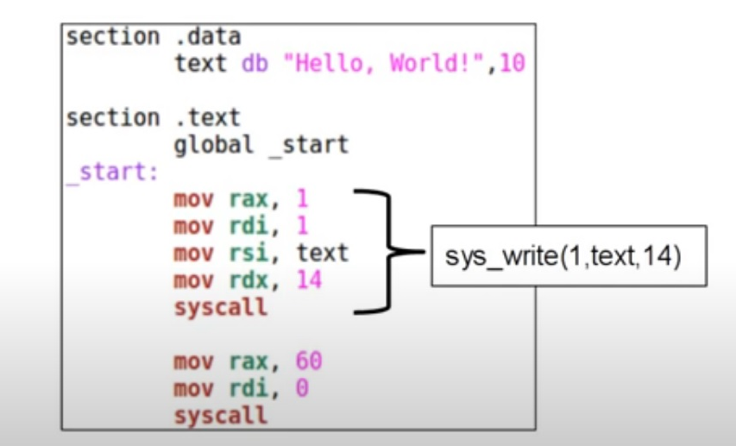
And….

Slide 19
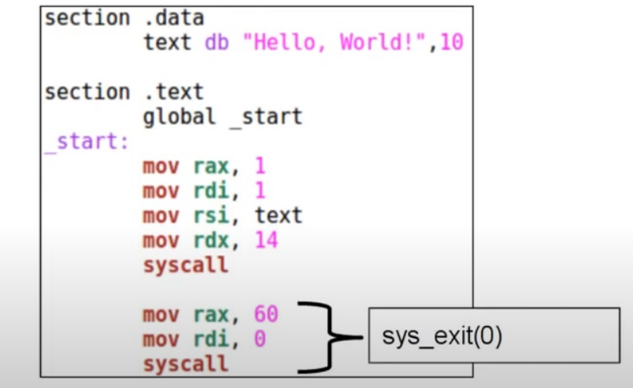
And….

Slide 20
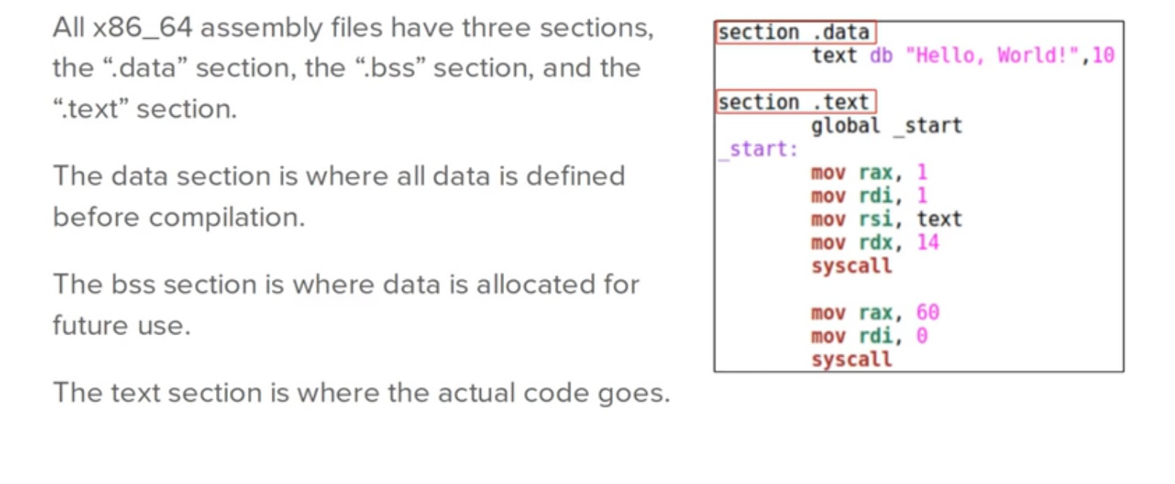
Sections onward….

Slide 21
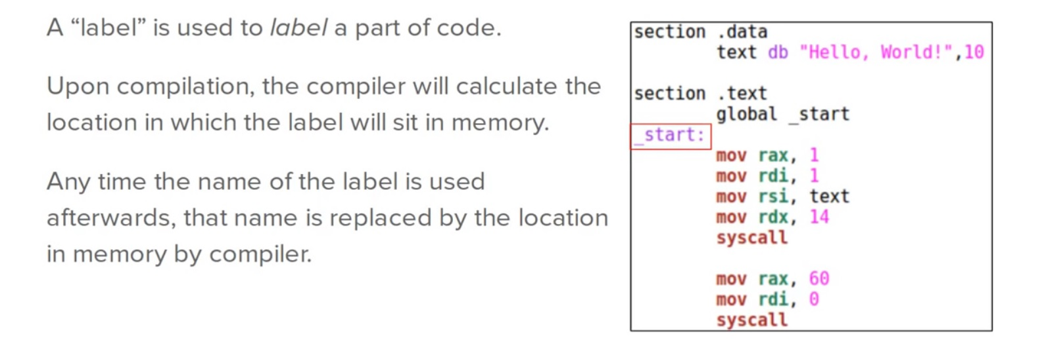
Labels Onward……

Slide 22
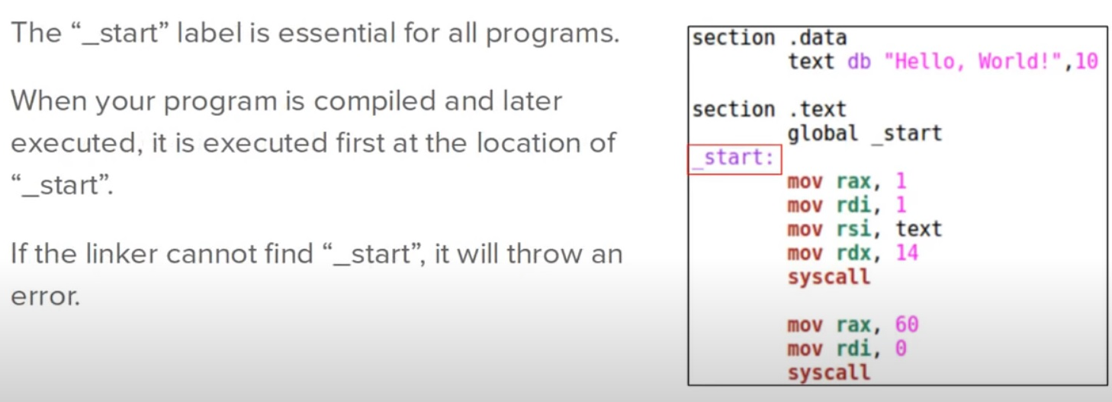
The “_Start” label

Slide 23
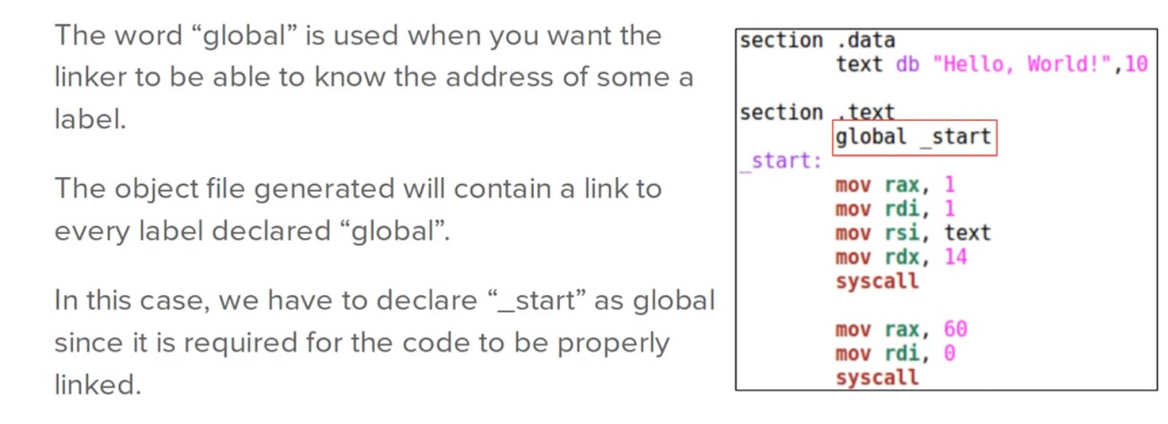
Global

Slide 24
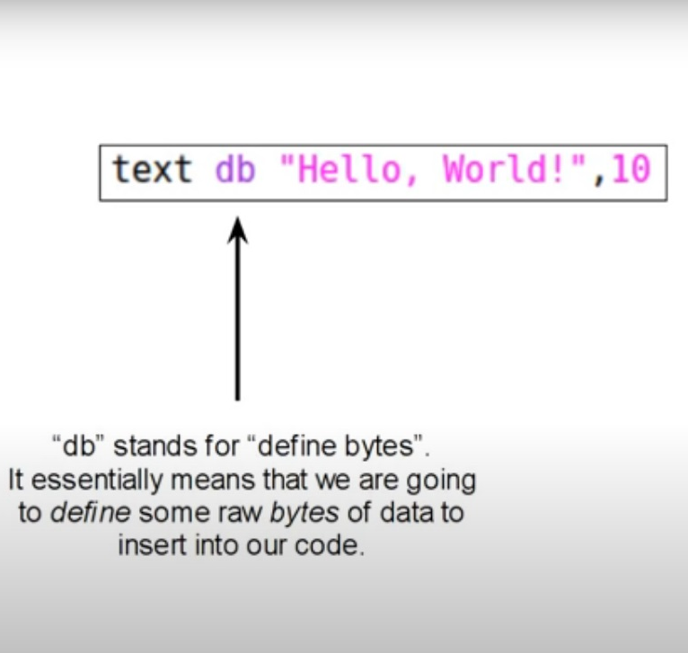
Other important ones…

Slide 25
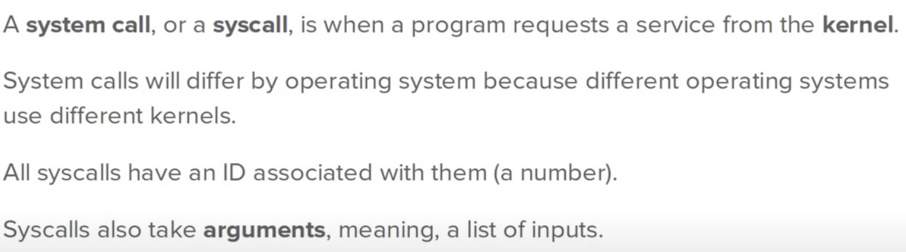
…System Call

Slide 26
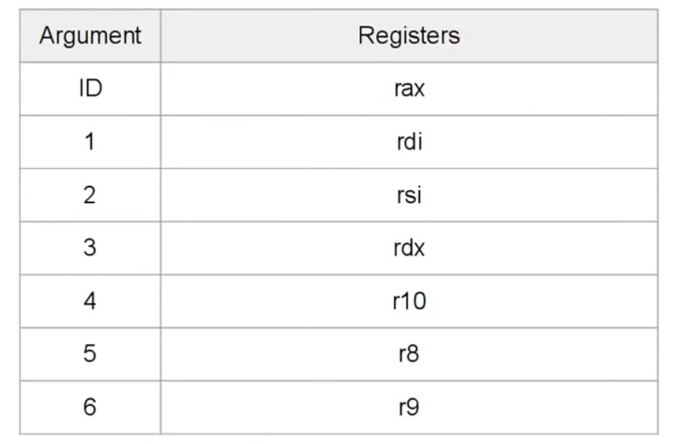
System call inputs by registers

Slide 27
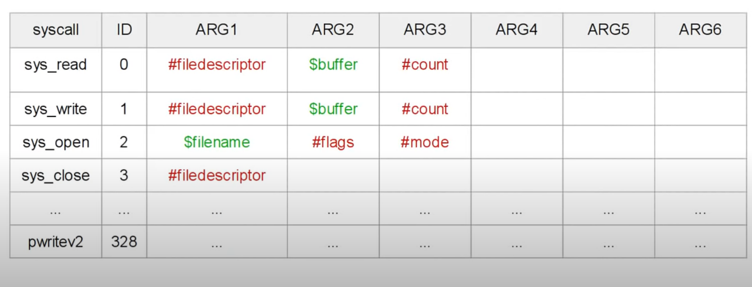
System Call List

Slide 28
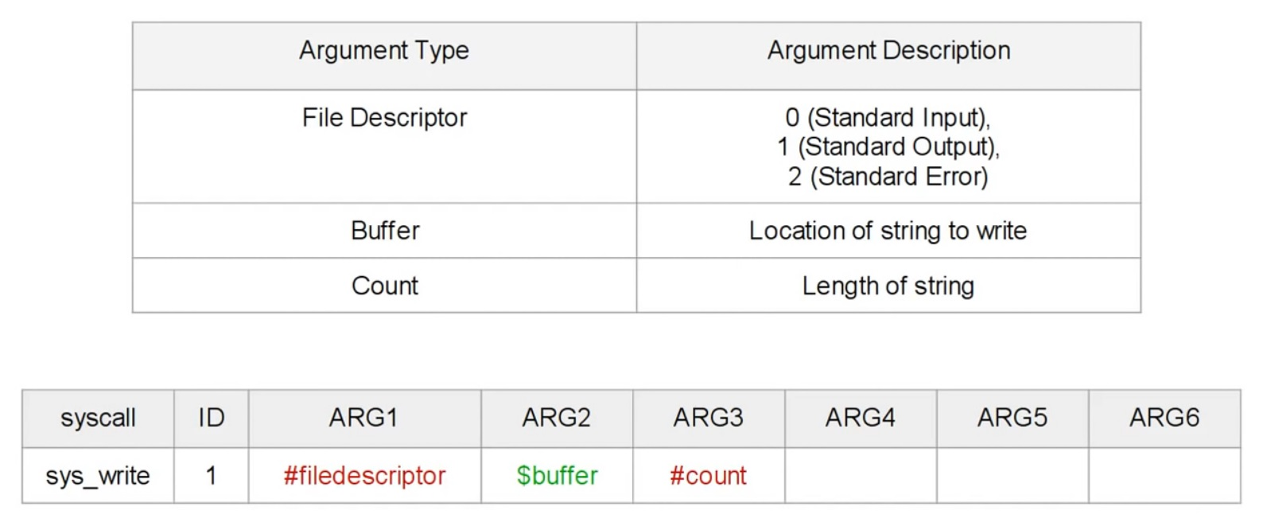
Sys_write

Slide 29
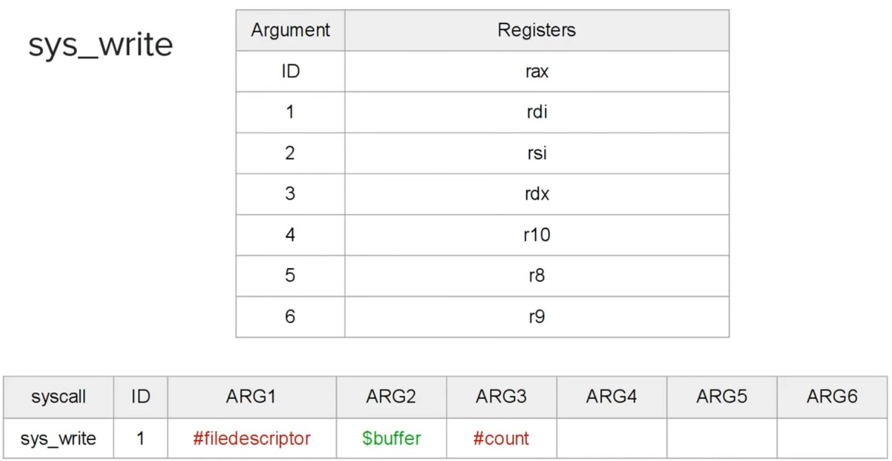
Sys_write

Slide 30
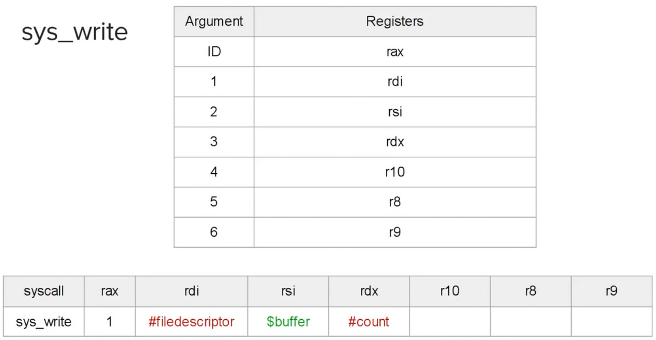
Sys_write

Slide 31
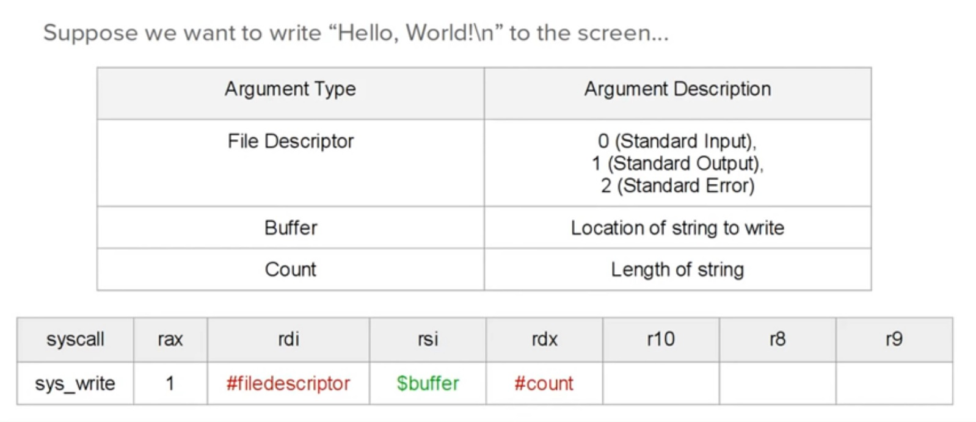
Sys_write

Slide 32
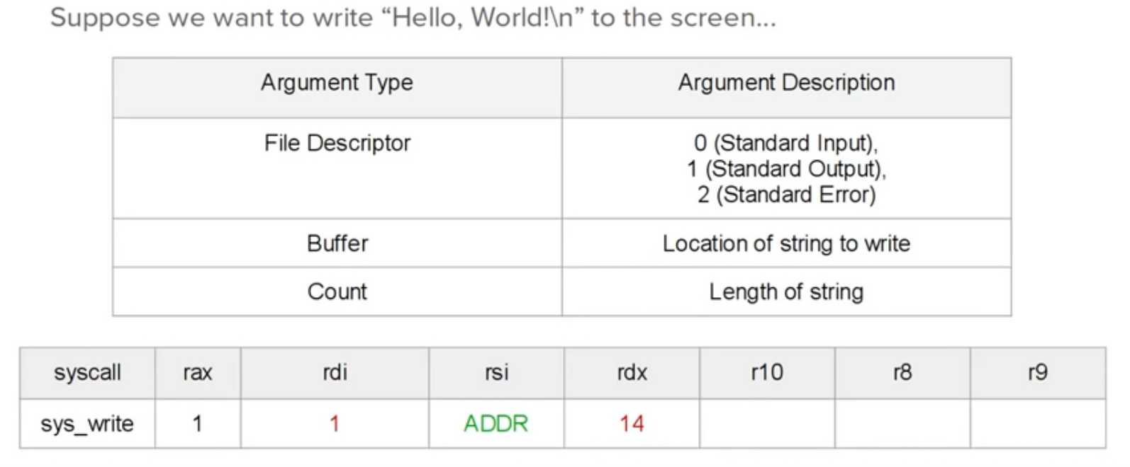
Sys_write

Slide 33
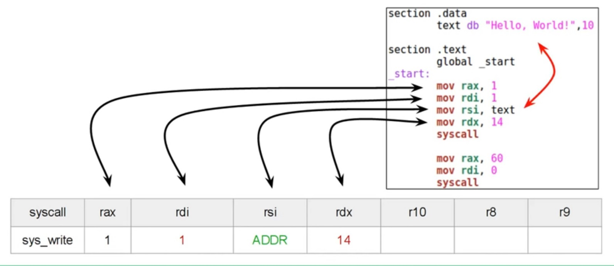
Sys_write

Slide 34
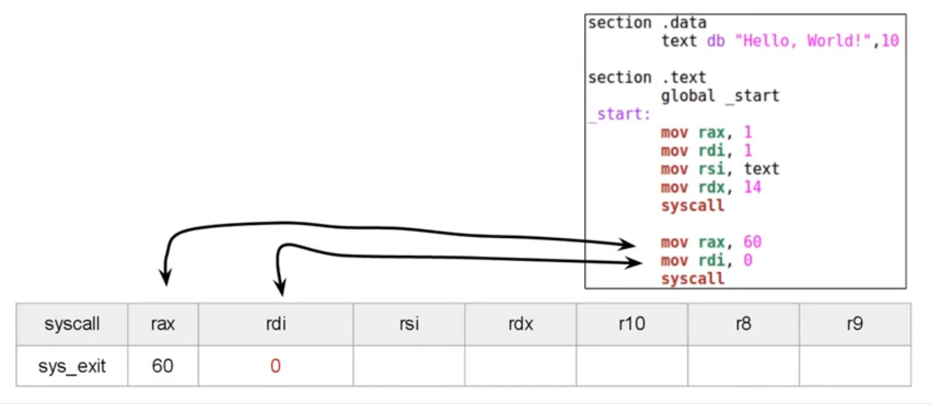
Sys_exit

Slide 35
Pointer Registers
The pointer registers are 32-bit EIP, ESP and EBP registers and corresponding 16-bit right portions IP, SP and BP. There are three categories of pointer registers:
Instruction Pointer (IP) - the 16-bit IP register stores the offset address of the next instruction to be executed. IP in association with the CS register (as CS:IP) gives the complete address of the current instruction in the code segment.

Slide 36
Sample programs done:
Hello_world.asm ;
display hello world on the screen
Addition.asm / Subtraction.asm ;
add/subtract two numbers and display the answer to screen
Compare.asm ;
compare 3 numbers and display the greatest on screen
See WhatsApp group for sample codes
Assignment:
Write the compare.asm code in 64 bits.
To be submitted on 3/06/2021

